Slide 1
Data Engineering 3 Term Project
John Joyce, Yuri Almeida, Istvan Janco

Slide 2
Analytics Plan
1
Loading data on collisions and precipitation using APIs
Build an ETL data pipeline to crate data tables
Create an analytical layer by combining the datasets
Make sure the analytical layer stays secure
Provide some basic analytics

Slide 3



Sources
2
Weather - National Centers for Environmental Information (NCDC) API
Collisions - "NYPD Motor Vehicle Collisions - Crashes” API

Slide 4
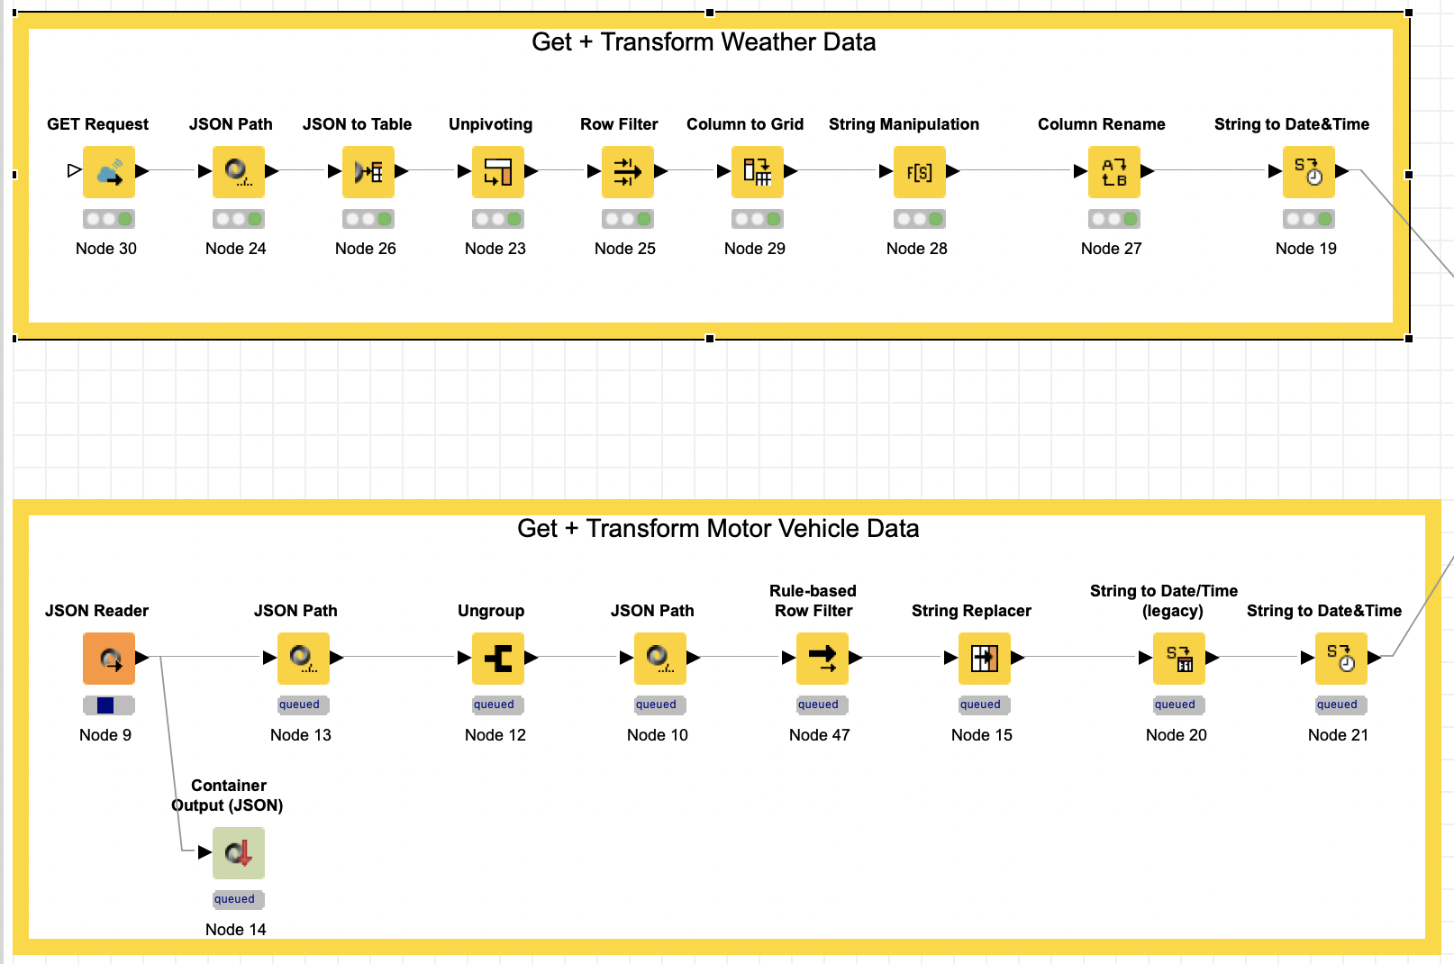
Data Extraction & Cleaning
3
Get data using APIs
Transform the data from JSON to tables
Clean the data

Slide 5
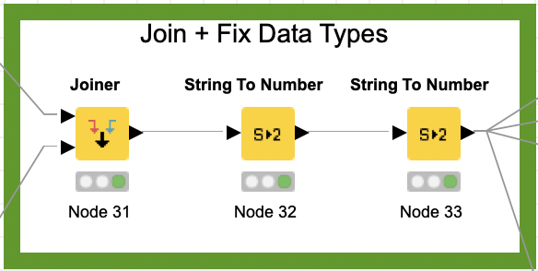
Analytical Layer
4
Join tables based on date
Creates an analytical layer by combining the datasets

Slide 6

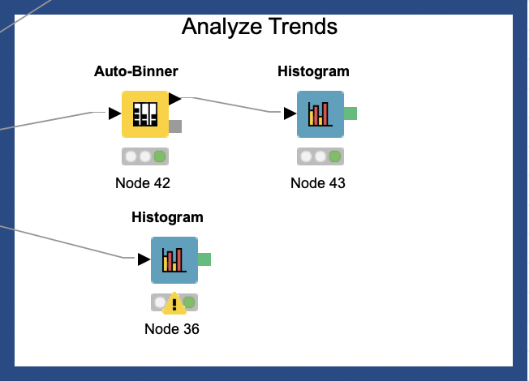
Analytics
5
Rate of injuries by precipitation

Slide 7
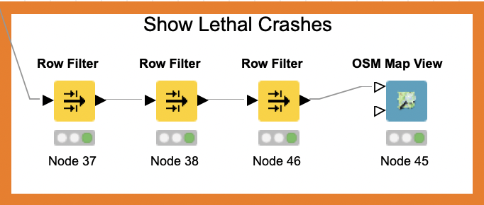
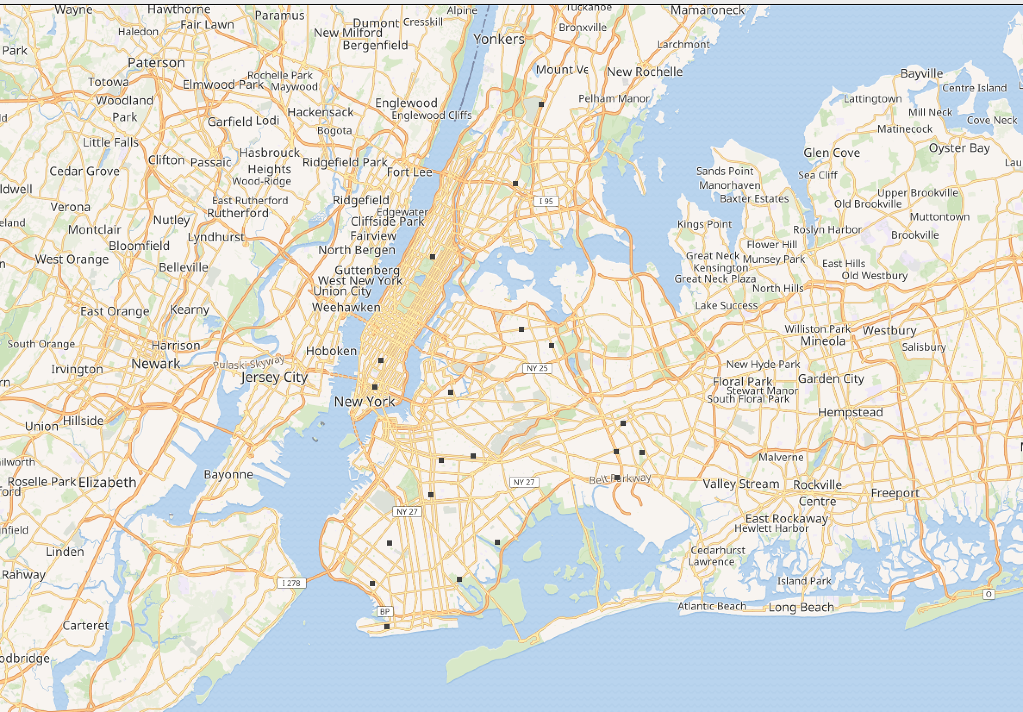
Analytics
5
Show where lethal crashes are happening

Slide 8
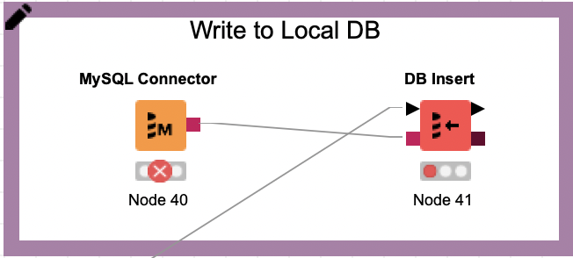
Repo (MySQL Server)
6
Writes the analytical layer ot a local MySQL
Makes sure the analytical layer stays secure

Slide 9
Thank You!

